Slide 1
Binary Arithmetic
Numbers Inside the Computer

Slide 2
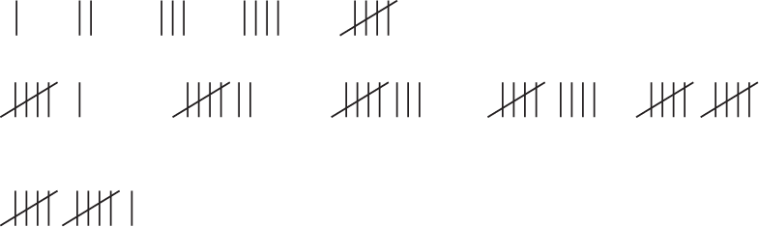
Counting
There are many different ways of writing numbers
  1,2,3,4,5,6,7,8,9,10,11 …
  I,II,III,IV,V,VI,VII,VIII,IX,X,XI …
  Etc.
One of the earliest ways of writing numbers was like this:

Slide 3
Number Systems
Counting using scratch marks is not very efficient. Try writing the number 1,000,000,000 using this method.
Roman Numerals was an improvement, but not much of one.
  You need to keep adding different letters for bigger numbers.
  At some point you will run out of letters and have to revert to scratch-mark methods.
Then came one of mankind’s greatest inventions.
The Zero!

Slide 4
Positional Notation
With positional notation, we can write pretty much any number we want.
First, we start using a scratch-mark method: we use a different symbol for each number.
0,1,2,3,4,5,6,7,8,9
But eventually, we get tired of making up new symbols, and write the following number.
  10
  This means that I’ve run through all my symbols one time, and I’m starting again with the first symbol in the list.
  20 means I’ve run through all my symbols twice.
  100 means that I’ve run through my entire list of symbols in the first two columns, but I’ve only done this once.

Slide 5
Running Out of Symbols
There is nothing magic about the number 10. It’s simply the number of different symbols I use to write numbers.
Suppose the person who invented all of this was lazy and didn’t want to make up 10 different symbols.
Suppose this person only invented five symbols, 0,1,2,3, and 4.
Then we would count like this:
0,1,2,3,4,10,11,12,13,14,20,21,22,23,24,30,31,32,33,34,…
I can still represent any number I want. These representations look like our normal numbers, but they aren’t.
10 represents our number 5. 21 represents our number 11, and 32 represents our number 17.
But everything would still work, counting, arithmetic, even long division!

Slide 6
Just Two Symbols
I can represent any number using any set of symbols, as long as I have more than one symbol.
The number of symbols is called the base or radix of the number system.
The minimum number of symbols is 0 and 1. (Otherwise we would be using scratch-marks.)
But I can still write any number I want using these two symbols, and the same counting principles I used with decimal numbers.
0,1,10,11,100,101,110,111,1000,1001, …
That’s a lot of digits, and I’m only up to 9. But I can still represent any number I want.

Slide 7
Arbitrary Bases
When I deal with numbers in more than one number system, I use subscripts to designate the base of the number system.
Thus 21₅ = 11₁₀ and 1001₂ = 9₁₀
The subscript is always written in decimal.
If the base is bigger than 10, then I need extra symbols to represent the digits bigger than 9.
For example, the Duodecimal Society has long advocated the use of the base-12 number system instead of base 10. They need two additional symbols, and have used a variety of different sets, including X and E.
In hexadecimal, base 16, we use A, B, C, D, E, and F (upper or lower case) to represent the 6 extra digits.

Slide 8
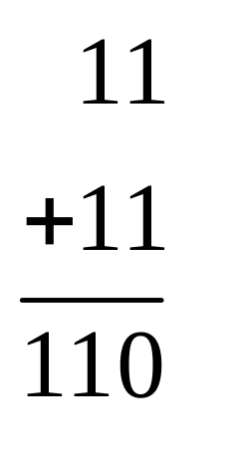
Binary Arithmetic
Add two numbers: 0+0=0, 0+1=1+0=1, 1+1=10.
The only time I need to carry is with 1+1.
Lets add 3 and 3.
The rightmost column had a carry into the second column giving us 1+1+1=11
As long as you remember the carries, the addition algorithm is trivial.

Slide 9
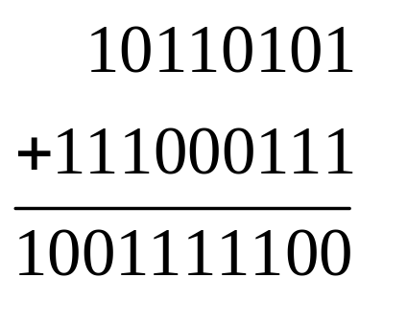
Adding Long Numbers
Try this:

Slide 10
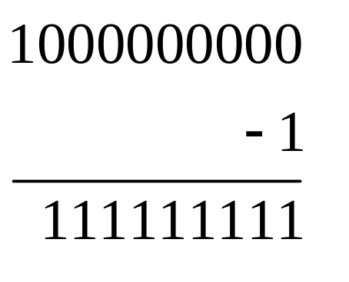
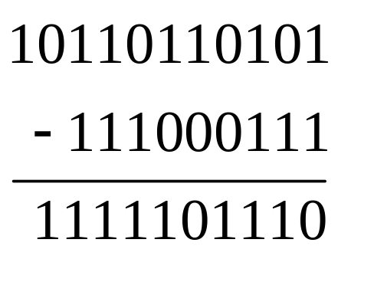
Subtraction
0-0=0, 1-0=1, 1-1=0, 0-1=1 with a borrow
The only time we need to worry is when we are subtracting a 1 from a 0.
Try this: and this:
At this point we will only subtract small numbers from big numbers.

Slide 11
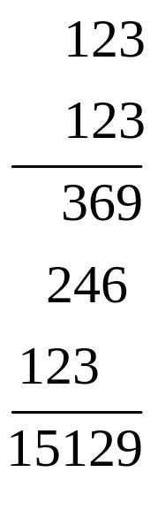
Multiplying Binary Numbers
In decimal, we multiply two numbers like this:
The numbers 369, 246, and 123 are called partial products.
Partial products are computed by multiplying a multi-digit number by a single digit.
In binary, the only single digits are 0, and 1. Easy Peasy!

Slide 12
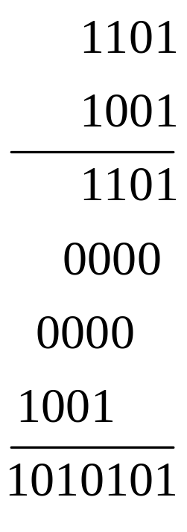
A Binary Example
An odd number of 1’s adds up to 1, plus some carries.
An even number of 1’s adds up to 0, plus some carries.
You don’t need to convert the carries to binary, just remember how many you have.

Slide 13
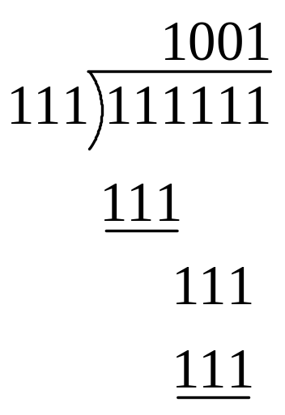
Division
Long division is the same as for decimal.
Guess a digit, then multiply it out and subtract to see if you were right. If you were wrong, correct and repeat.
In binary, the guesses are just 0 and 1, and it’s easy to see which guess is correct.
The following is an example:

Slide 14
Conversions
But the question remains:
How do I convert from one number system to another?
Let’s start with an easier question.

Slide 15
Enumerating Digits
Suppose I start with a decimal number, say 2137869, and I want an algorithm to enumerate the digits one by one.
If I divide 2137869 by 10, I get a quotient of 213786 and a remainder of 9.
If I divide by 10 again, I get a quotient of 21378 and a remainder of 6.
Another division by 10 gives me the quotient 2137 and a remainder of 8.
If I output the remainders as I get them, I will enumerate the digits of 2137869, in reverse order.
I stop when the quotient becomes zero.
Will this work for Binary? Will it work for other bases?

Slide 16
Converting to Binary
YES IT WILL WORK FOR BINARY!
Lets start with 100₁₀ and divide it by two repeatedly until the quotient is zero.
100₁₀ = 1100100₂.
Remember, the digits come in reverse order!
Divisor | Quotient | Remainder
2 | 100 | x
2 | 50 | 0
2 | 25 | 0
2 | 12 | 1
2 | 6 | 0
2 | 3 | 0
2 | 1 | 1
2 | 0 | 1

Slide 17
Other Bases
This technique will work for any base.
Let’s try converting 100₁₀ into trinary (Base 3)
Thus 100₁₀ = 10201₃
Divisor | Quotient | Remainder
3 | 100 | x
3 | 33 | 1
3 | 11 | 0
3 | 3 | 2
3 | 1 | 0
 | 0 | 1

Slide 18
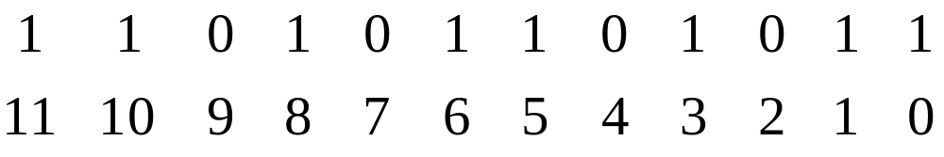
Back to Decimal
Given a binary number 110101101011, I could convert it back into decimal by repeatedly dividing by 10₁₀.
This will work, but it’s tedious because the division must be done in binary and 10₁₀=1010₂
The remainders will be 0,1,10,11,100,101,110,111,1000, and 1001, and you will have to remember which decimal digit corresponds to each.
Easier:
Number the digit positions from the right starting with zero.

Slide 19
What Positional Notation Means
Remember that when we write a base 10 number like 493217 what we mean is this:
It’s the same in binary. 110101101011 just means
Returning to our numbering:
We ignore the zero positions and add up the powers of 2 corresponding to the ones.

Slide 20
Adding Powers of 2
Thus 110101101011 = 2¹¹+2¹⁰+2⁸+2⁶+2⁵+2³+2¹+2⁰.
And of course 2¹¹+2¹⁰+2⁸+2⁶+2⁵+2³+2¹+2⁰ =2048+1024+256+64+32+8+2+1=3435
And of course, you know the powers of 2, right?
MEMORIZE THEM! (up to 16)

Slide 21
Study this table!
0 – 1
1 – 2
2 – 4
3 – 8
4 – 16
5 – 32
6 – 64
7 – 128
8 – 256
9 – 512
10 – 1,024
11 – 2,048
12 – 4,096
13 – 8,192
14 – 16,384
15 – 32,768
16 – 65,536
17 – 131,072
18 – 262,144
19 – 524,288
20 – 1,048,576
21 – 2,097,152
22 – 4,194,304
23 – 8,388,608

Slide 22
And This
24 – 16,777,216
25 – 33,554,432
26 – 67,108,864
27 – 134,217,728
28 – 268,435,456
29 – 536,870,912
30 – 1,073,741,824
31 – 2,147,483,648
32 – 4,294,967,296

Slide 23
Electronics and Numbers
Binary works really well for electronics. Many electrical systems have two states:
  Switch: On/off
  Wires: High/Low voltage
  Conductors: Current flowing/not flowing
  Magnets: Magnetized, not magnetized, North/South Pole
  Batteries: Positive voltage, negative voltage
  Capacitors: charged, not charged

Slide 24
Additional Concerns
The Binary System is a natural fit for electronics, BUT
How do we represent negative numbers with only two symbols?
How do we represent decimal points?
How do we represent fractions?
How do we represent “really big” numbers?
All of these questions must be answered before we can claim to have a number system that “really works.”

Slide 25
Fixed-Width Numbers
The arithmetic units of a computer are hardware.
The registers and memory cells where I store numbers are hardware.
I can’t make additional room for more digits.
I’m stuck with whatever the hardware designer has given me.
ALL NUMBERS HAVE THE SAME NUMBER OF DIGITS!!!!
1 is 00000001, 2 is 00000010, 3 is … you get the idea.
These are 8-bit fixed width numbers.
In modern computers, you have a choice of different lengths.
8 bits, 16 bits, 32 bits, and 64 bits.
These are char, short, long or int, and long long in C++.

Slide 26
Negative Numbers
It’s easy to represent negative numbers in decimal. -1, -2, -3, …
Why can’t I do that in binary? -1, -10, -11, …
On paper, I can. In a computer, the minus sign is a THIRD SYMBOL. I only have two symbols. 1 and 0.
So in the fixed width format, select one bit and call it the sign bit. Let 1=negative and 0=positive.
The first bit on the left is normally chosen for this purpose.
The sign bit is also called the High Order Bit of the number.
The last bit on the right is called the Low Order Bit.
Thus 1,2,3,… =00000001,00000010,00000011, …
And -1,-2,-3,… = 10000001,10000010,10000011, …

Slide 27
Problems With Signs …
Using the sign bit as a positive/negative indicator, with no other changes, is called Signed Magnitude Representation.
Zero is 00000000. Negative zero is 10000000. But, actually, there’s no such thing as negative zero!
How do you add?
Compare signs, if the signs are the same, add the absolute values (all bits except the leftmost). The sign of the result is the sign of the operands.
If signs are different, compare absolute values. Subtract the smaller absolute value from the larger absolute value. The sign of the result is the sign of the larger absolute value.
This is complicated. Complicated algorithms mean complicated, slow, and expensive, hardware.

Slide 28
Something Better!?
Suppose, when changing the sign of a number, I invert ALL bits instead of just the first one?
-1,-2,-3, would be 11111110, 11111101, 11111100, …
Would this be any better?
We still have + and – zero: 00000000, and 11111111
Let’s try using some numbers.
2+2, 00000010+0000010=00000100=4
2+(-2), 00000010+11111101=11111111=0
(-2)+(-2) 11111101+11111101=11111010=-5. OOOPS!
Now for the weirdness: we have a carry out of the sign position.
For unsigned numbers, this would be an overflow.
For these numbers, we have to add the carry out of the sign position to the low order digit position. 11111010+1=11111011=-4

Slide 29
Something Even Better
Inverting every bit is called the One’s Complement of a number. In C++ the statement x=~y; computes the one’s complement of y and puts it in x.
Suppose, instead of just complementing every bit, I complement every bit, and add 1 to the result. (Why? Because it works!)
I have just one zero. 00000000->11111111+1=00000000
-1,-2,-3… = 11111111, 11111110, 11111101, …
Lets try it.
2+2=00000010+00000010=00000100=4
2+(-2)=00000010+11111110=00000000=0
(-2)+(-2)=11111110+11111110=11111100=-4

Slide 30
Two’s Complement
Complementing every bit and then adding one is called the Two’s Complement of a number.
Two’s Complement is used for negative integers on all modern computers. To compute the Two’s complement of a variable x, in C++, use the following statement: y=-x;
How do we convert a negative number to positive? The same way we made it negative. Complement every bit and add 1.
-2=11111110->00000001+1=00000010=2
Don’t bother trying to “reverse the steps.” Just complement every bit, and add 1.
The Two’s complement operation is an order-2 operator. This means if I do it twice, I get the original input back. One’s complement is an order-2 operator. There are many others.

Slide 31
Excess Notation
Another way to represent negative numbers is to choose some number and just call it zero.
Numbers are treated as unsigned.
Anything less than the assumed zero is negative, anything larger is positive.
The assumed zero is called the Bias
An example, using four bits.
We’ll call 0111 zero. 1000 is 1, 1001 is 2.
Arithmetic is tricky. There will be many intermediate overflows, so “protection” bits are needed.
2+2=1001+1001=10010 *** OVERFLOW!
When I add, I must subtract out the assumed zero, because the result will have the Bias added twice.
2+2=1001+1001=10010-0111=1011=4
When subtracting, I must add the bias back in.
2-2=1001+1001=0000+0111=0111=0

Slide 32
What Is Really Used?
Two’s complement is used in all integer arithmetic. This includes the types char, int, short, long, and long long in C++.
Signed magnitude and excess notation is used in floating point numbers. This includes the types float, double, and long double in C++.
One’s complement is not used. The end-around carry makes for clumsy design.

Slide 33
Fractions
Fractions are represented using the binary analog of the decimal point.
In binary, the correct term is “binary point.”
Like 1/3=.33333… many fractions lead to repeating binary expansions.
Other methods of representing fractions have been tried, but none has ever caught on.
To compute the binary expansion of a number we use multiplication.

Slide 34
Motivation
Consider the decimal number .12379.
If I multiply this number by 10 I get 1.2379.
If I write the digit to the left of the decimal point down separately, and then delete the digit, I end up with:
1 and .2379.
If I do the same thing again, I get:
1,2 and .379
Repeating, I get:
1,2,3, and .79.
Note that this technique enumerates the digits of the decimal representation.
If multiply by 2 instead of 10, I will get the digits of the binary representation.

Slide 35
An Example Fraction
Let’s try the multiplication procedure with .825
Multiply by 2: 1.75.
We get 1 and .75
Multiply by 2: 1.5
We get 1,1 and .5
Multiply by 2: 1.0
We get 1,1,1 and .0
We stop. The list 1,1,1 is the digits of the binary representation from high-order bit to low order bit.
Thus: .825₁₀=.111₂

Slide 36
Another Example
Let’s try this with .1 (1/10)
Multiply by 2: 0.2, yielding .0 and .2
Multiply by 2: 0.4, yielding .00 and .4
x2 again: 0.8, yielding .000 and .8
x2 again: 1.6, yielding .0001 and .6
x2 again: 1.2, yielding .00011 and .2
x2 again: 0.4, yielding .000110 and .4
x2 again: 0.8, yielding .0001100 and .8
x2 again: 1.6, yielding .00011001 and .6
x2 again: 1.2, yielding .000110011 and .2
x2 again: 0.4, yielding .0001100110 and .4
.1 is a repeating binary expansion, even if it is exact base 10.

Slide 37
When Do Expansions Repeat?
Let a/b be a fraction in its lowest terms, and let p₁,p₂, … ,p_{k} be the complete list of prime numbers that divide b.
Let r be some radix, and let q₁,q₂,…,q_{n} be the complete list of prime numbers that divide r.
If every prime in the list p₁,…,p_{k} also occurs in the list q₁,…,q_{n}, then the expansion of a/b is finite. Otherwise it is infinite repeating.
In decimal, this means that b must be of the form 2^{x}5^{z} for the decimal expansion to be finite.
In binary, b must be a power of 2.
Everything that is finite in binary is also finite in decimal, but the reverse is not true.

Slide 38
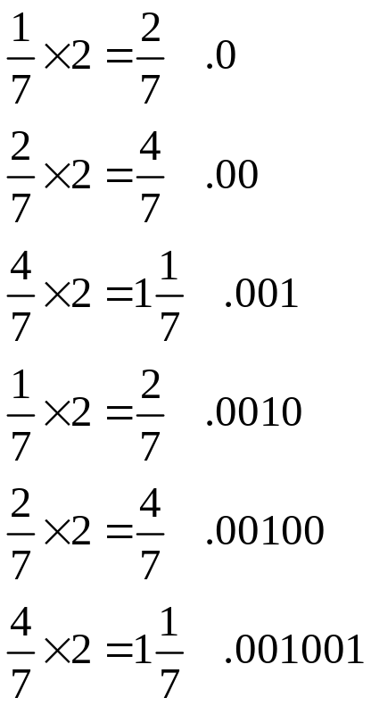
Converting Fractions Directly
The multiplication technique can be used with fractions directly.
This might be a good way to convert 1/7 without introducing two “round-off” errors.
Multiply the fraction by 2
If the result is less than 1,
the next digit is 0.
If the result is greater than 1,
the next digit is 1. Subtract 1
and continue.
Stop when the result is 0, or
when you have enough digits.

Slide 39
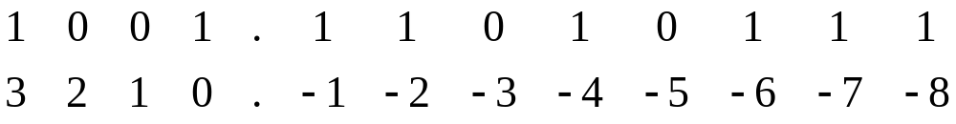
Back to Decimal
The procedure for converting binary expansions back to decimal is identical to that for integers.
Negative powers of two are used.
Convert 1001.11010111 to decimal.
Number the bit positions like this:
So 1001.110101112 =
2³+2⁰+2⁻¹+2⁻²+2⁻⁴+2⁻⁶+2⁻⁷+2⁻⁸=
8+1+.5+.25+.0625+.015625+.0078125+.00390625=
9.83984375
Finite binary expansions and finite decimal expansions are always the same length, provided they both exist.

Slide 40
Octal and Hexadecimal.
We very often deal with 32-bit quantities in programming, and we frequently need to see the binary representation of a number.
Suppose the correct value of variable x is 00010101011101011101011111011101
But when you print out the number, you get 00010101011101011101011110011101 instead.
Can you see the difference? If you found it, was it EASY to find it?
32-bit numbers binary numbers are just too big to deal with easily. Therefore, programmers have traditionally used octal (base 8) and hexadecimal (base 16) representations of their numbers.

Slide 41
Octal Representations
If you already have the binary representation of a number, you can compute the octal representation very easily.
First create the following table:
0 – 000
1 – 001
2 – 010
3 – 011
4 – 100
5 – 101
6 – 110
7 – 111
Then break your number up as follows, starting from the right
00,010,101,011,101,011,101,011,111,011,101 add a leading zero to make a group of three.
Use the table to substitute for each group: 02535353735
Can you see the difference now? 02535353635

Slide 42
Octal to binary
To convert 21132765 to binary, use the table in reverse.
010001001011010111110101
You can eliminate the leading zero if you wish.
10001001011010111110101
To convert from octal to decimal, it’s easiest to convert to binary and then to decimal.
For decimal to octal, convert to binary first, and then to octal.
You can convert directly if you wish. Do you know the powers of 8?
Octal is seldom used these days. Hexadecimal is more common.

Slide 43
Hexadecimal Conversions
Hexadecimal conversions are just like octal conversions, we just need a bigger table.
0 – 0000 8 – 1000
1 – 0001 9 – 1001
2 – 0010 A – 1010
3 – 0011 B – 1011
4 – 0100 C – 1100
5 – 0101 D – 1101
6 – 0110 E – 1110
7 – 0111 F – 1111
We convert 4 bits at a time, starting from the right like this: 0001,0101,0111,0101,1101,0111,1101,1101
Now we use the table to get 1575D7DD
Compare that to 1575D79D See the difference now?

Slide 44
Hex with Binary Points.
Suppose we want to convert the following number to hexadecimal (hex)
111100101010110.00101010100101
On the left side of the binary point, we insert commas like this:
111,1001,0101,0110 . 00101010100101
On the right side of the binary point, we proceed from right to left like this:
111,1001,0101,0110 . 0010,1010,1001,01
Now add leading and trailing zeros to make groups of 4:
0111,1001,0101,0110.0010,1010,1001,0100
And use the table to get: 7956.2A94

Slide 45
Hexadecimal and Decimal
As with octal, it is easier to convert from hexadecimal to binary and then to decimal. Unless you know the powers of 16 and their multiples.
So to convert AC7 to decimal, we convert first to binary,
101011000111 and then compute
1+2+4+64+128+512+2048=2759
Unless you’re adept at dividing by 16, it’s easier to convert from decimal to binary and then to hexadecimal.
For example 100₁₀=1100100₂=64₁₆.

Slide 46
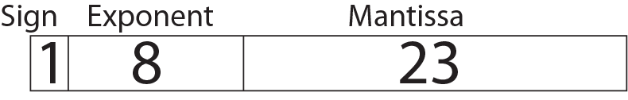
IEEE Floating Point Format
If you had the following line of C++:
  float x = 1.0;
What would you expect to see, if you had a hex dump of x?
The correct answer is 3F80000. Did you guess correctly?
Here’s why. A float is 32 bits long, divided into 3 sections like this:
Floating point numbers use Scientific notation like this:
3.14x10⁶
Except the base is two so its times 2^{n} instead of 10^{n}.

Slide 47
Floating Point Structure
In numbers such as 3.14x10⁶, 3.14 is the mantissa, and 6 is the exponent.
Both the exponent and the mantissa have a sign.
The SIGN portion of the float is the sign of the mantissa.
The exponent is expressed in excess 127 notation (7F in hex).
Exponents of all zeros and all ones are reserved for special purposes.
The mantissa has a single digit to the left of the binary point, and the number must be normalized (no leading zeroes.)
Since the digit to the left of the binary point is always 1, it is omitted, so the 23 mantissa digits all appear to the right of the binary point.
1.0 = 1.00000000000000000000000x2⁰
The 23 stored mantissa bits are all zero. The exponent is 01111111 and the sign is 0, so we get:
0011,1111,1000,0000,0000,0000,0000,0000=3F800000

Slide 48
Double and Long Double
Variables of type double are 64 bits long. There is one sign bit, 11 exponent bits with a bias of 3FF, and 52 stored mantissa bits. The high order bit of the mantissa must be 1 and is not stored.
Variables of type long double are 80 bits long. There is one sign bit, 15 exponent bits with a bias of 3FFF, and 64 mantissa bits. Long doubles need not be normalized, and the high order bit, which can be one or zero, is stored along with the bits to the right of the binary point.
Some hardware supports quad length floating point numbers, but these are non-standard.
Long doubles were originally intended for internal use only, and were not intended for use by ordinary programmers.

